Slide 1





STUDENT CREDENTIALS
Abir Ekansh
UNIVERSITY INTERNSHIP REPORT
Enrollment / Roll No. 25SCS1003005283
Section & Program 2CSE31 | B.Tech (CSE)
Web Development Internship
Social Media and E-Commerce Platforms
HOST ORGANIZATION
Codec Technologies
INTERNSHIP DURATION
Guided & Deployed Open-Source Frameworks
June 2026 – August 2026 (8 Weeks)

Slide 2


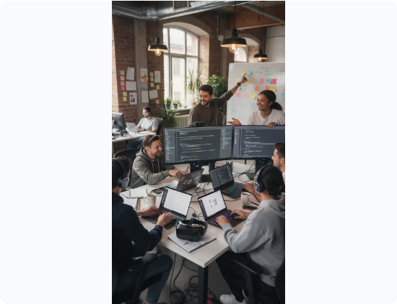
Candidate & Program Overview
■
Student Name: Abir Ekansh
■
Roll Number: 25SCS1003005283
■
Section: 2CSE31
■
Degree: B.Tech (Computer Science & Engineering)
■
University: IILM University, Greater Noida, U.P.
■
Primary Focus: Full-Stack Web Development
■
Core Deliverables: Social Media App & E-Commerce Platform

Slide 3









The Industry Challenge & Problem Statement
Fragmented Engagement
Retail Inefficiencies
Secure Architectures
Existing e-commerce frameworks are often overly complex to scale. There is a strong need for streamlined online shopping, optimized cart states, and secure checkout experiences.
The primary engineering challenge lies in architecting systems from scratch that handle robust user authentication, real-time data flow, and secure state management flawlessly.
In the digital age, users require seamless, high-performance platforms to communicate and share media without relying on bloated, generalized legacy solutions.

Slide 4
Core Project Objectives
Social Network Implementation: Construct a scalable Social Application allowing users to seamlessly create profiles, authenticate securely, post updates, and interact.
E-Commerce System Development: Develop a robust E-Commerce system featuring a dynamic product catalog, state-managed shopping cart functionality, and simulated secure checkout.
Responsive User Interfaces: Implement modern, highly responsive frontend interfaces that provide optimal and engaging UI/UX experiences across varying device screen sizes.
Robust Backend Infrastructure: Design and deploy backend RESTful APIs capable of secure database CRUD operations and efficient data retrieval pipelines.

Slide 5



Technologies & Tools Used
Frontend Development
Backend Architecture
Database & Deployment
Utilized HTML5, CSS3, JavaScript, and React.js to build dynamic, component-based user interfaces and manage complex application states effectively on the client side.
Leveraged Node.js and Express.js to create a structured server environment, enforce strict business logic, and process JSON Web Tokens (JWT) securely.
Implemented MongoDB/SQL for relational and document data management, while utilizing Git and GitHub for continuous version control and project hosting.

Slide 6
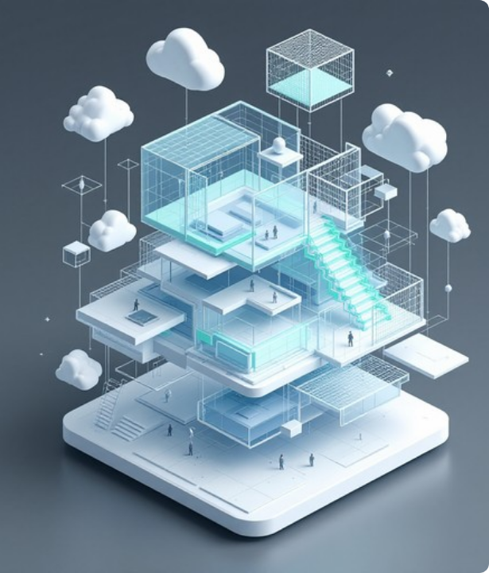
System Architecture
Client-Server Model
Both applications leverage a strict Client-Server architecture to separate concerns, improve security, and enhance scalability.
The React-based frontend layers handle data presentation and state management, communicating asynchronously with Node.js REST APIs. The backend services enforce business logic, process tokens, and execute CRUD operations securely against the database clusters.

Slide 7




Agile Development Methodology
Sprint 2 - Backend APIs
Sprint 4 - Deployment
Building, securing, and rigorously testing backend REST API endpoints and core server logic operations.
Thorough full-stack testing, debugging, repository finalization, and deployment of both web applications.
Sprint 1 - Planning
Sprint 3 - UI/UX
Initial focus on gathering strict requirements and mapping out logical database schemas for users and products.
Iterative development and integration of interactive React frontend components based on backend functionality.

Slide 8





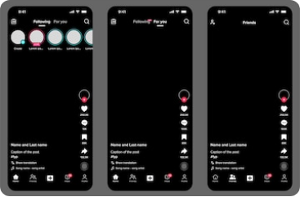



Expected Outcomes & Deliverables
Social Platform
E-Commerce System
Robust Deployment
A fully functional social app demonstrating clear proficiency in managing relational user data, secure authentication, and dynamic social feeds.
A digital storefront showcasing the ability to handle complex transactional logic, product states, and seamless cart session management.
Two scalable digital platforms built from scratch utilizing modern web development architectures, available on GitHub.

Slide 9
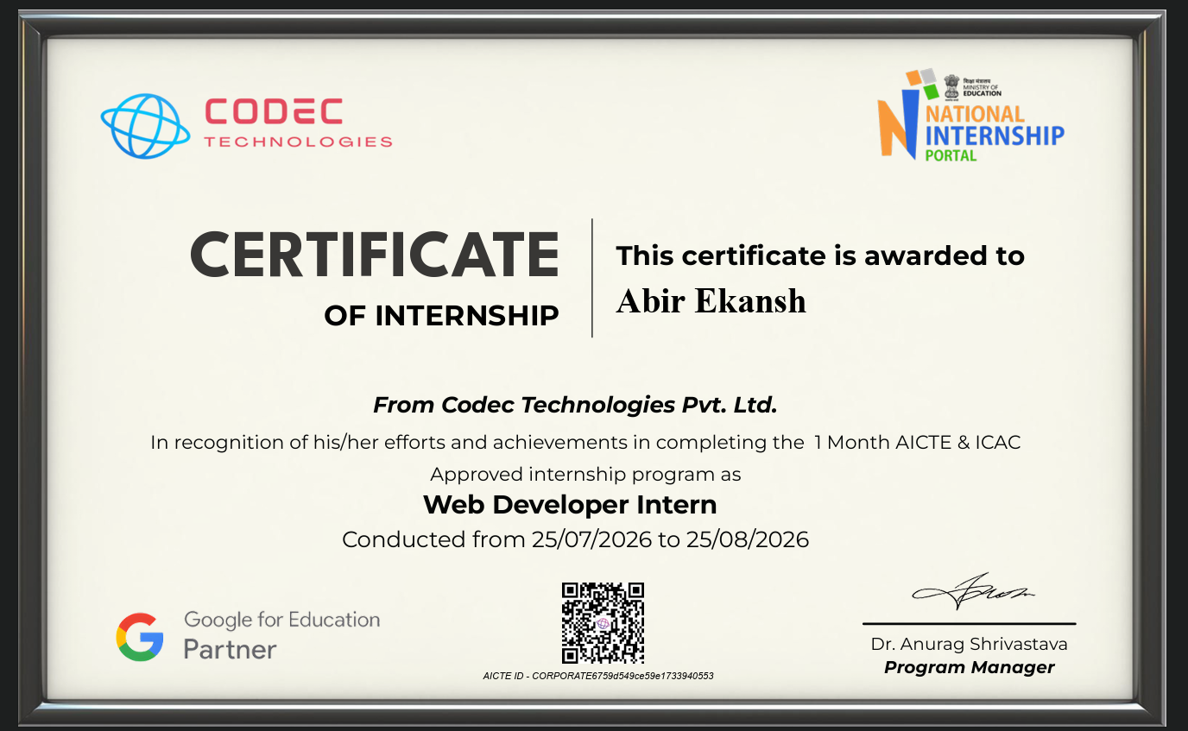

Slide 10

Thank You!
End of Presentation

